Slide 1
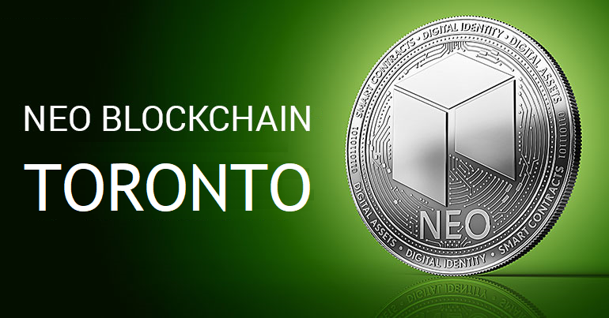
NEO Blockchain TORONTO
Welcome Neoxplorers!
“Genesis Block 0” Meetup – March 24, 2018
https://www.meetup.com/NEO-Blockchain-Toronto/
neotoronto@outlook.com

Slide 2
Agenda
Introductions
What is NEO?
Why NEO?
NEO Resources
NEO Blockchain Quick Start Guide for .NET Developers
Networking

Slide 3
Introductions
Lead Neoxplorer: Michael Herman E: mailto:neotoronto@outlook.com M: https://www.meetup.com/NEO-Blockchain-Toronto G: https://github.com/mwherman2000/neo-windocs/events F: https://www.facebook.com/neotoronto/ T: https://www.twitter.com/neotoronto
Who are you?
Crytopinvestor?
Software Developer/Achitect?
Legal profession?
Financial services (convention)?

Slide 4
What is NEO Blockchain Toronto?
NEO Blockchain Toronto (https://www.meetup.com/NEO-Blockchain-Toronto/) is a non-profit, community-based Meetup group for blockchain developers and architects interested in designing and creating Distributed Ledger Technology (DLT) (aka blockchain) solutions using the NEO Blockchain platform.
We call ourselves Neoxplorers
Meetup second Wednesday evening of each month
April 11, May 9, June 13, …
This meetup is a group that it is (currently) independent of the official NEO Project (https://github.com/neo-project) and COZ (https://github.com/CityOfZion/) projects. I'm looking forward to this changing in the future.
More importantly, NEO Blockchain Toronto is what we want to make it!

Slide 5
Our Values as Neoxplorers
We operate like a blockchain
Decentralized
Community based
Consensus driven
Creators of value
Store value
Transfer value
Multi-disciplinary
Multi-application
Multi-technology
We behave like a blockchain
Robust
Reliable
Transparent
Smart
Open
Non-discriminatory
Participatory
Diversity
Committed

Slide 6
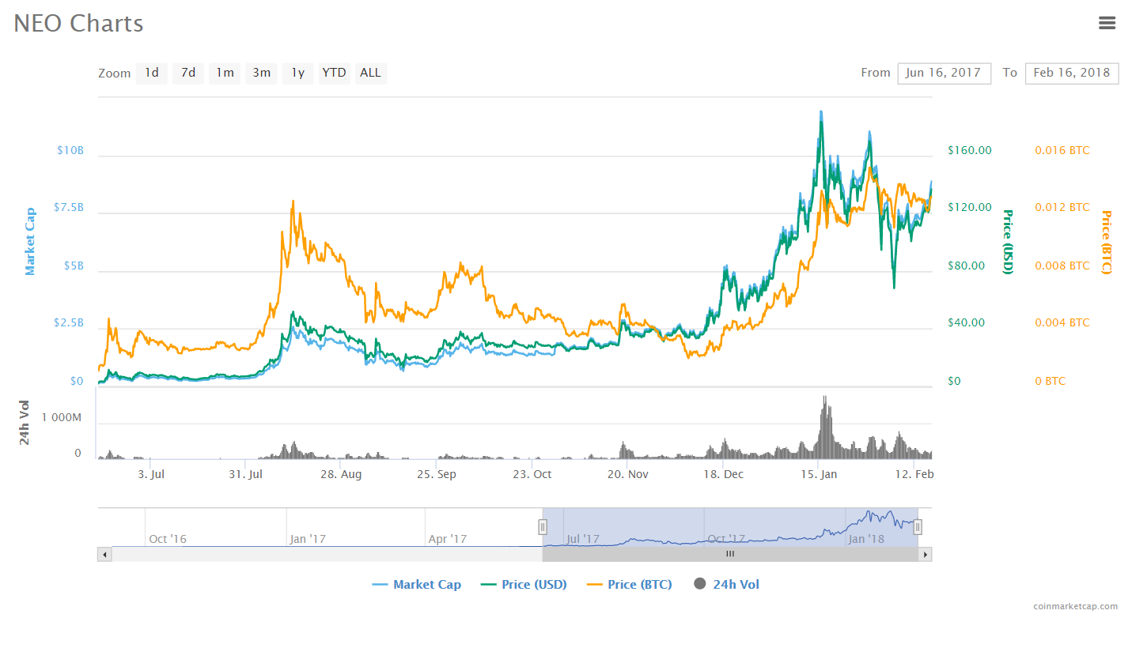
What is NEO?
PROJECT: NEO (https://neo.org/) is a non-profit, community-based blockchain project that utilizes blockchain technology and digital identity to digitize assets, to automate the management of digital assets using smart contracts, and to realize a "smart economy" with a distributed network.
CRYPTOCURRENCY: $NEO
SOFTWARE PLATFORM: Programmable Smart Contract blockchain platform
Multiple languages: C# (reference implementation), Python, Java, Golang, JavaScript
GLOBAL COMMUNITY
Discord: https://discord.gg/gqCYeup (like Slack)

Slide 7
Why NEO?
Vision
TODO
Goals
TODO
TODO
TODO
Differentiators
TODO
TODO
TODO

Slide 8
NEO News
Who is switching to NEO?

Slide 9
NEO Resources
General
NEO.org http://neo.org
TODO
TODO
Developers
NEO Blockchain developer guidance for Microsoft .NET developers (neo-windocs) https://github.com/mwherman2000/neo-windocs
City of Zion awesome-neo project https://github.com/CityOfZion/awesome-neo/
The NEO Project https://github.com/neo-project

Slide 10
NEO Blockchain Quick Start Guide for .NET Developers
https://github.com/mwherman2000/neo-windocs
/blob/master/windocs/quickstart-csharp/README.md
TODO

Slide 11
Our Values as Neoxplorers
We operate like a blockchain
Decentralized
Community based
Consensus driven
Creators of value
Store value
Transfer value
Multi-disciplinary
Multi-application
Multi-technology
Multi-industry
We behave like a blockchain
Robust
Reliable
Transparent
Smart
Open
Non-discriminatory
Participatory
Diverse
Committed
Watching out for the next person

Slide 12

Thank you for coming out this evening
Happy St. Patrick’s Day
Neoxplorers!
Meetup the second Wednesday evening of each month:
April 11, May 9, June 13

Slide 13
Backup Slides

Slide 14
NEO Blockchain TORONTO
Welcome Neoxplorers!
“Genesis Block 0” Meetup – March 24, 2018
https://www.meetup.com/NEO-Blockchain-Toronto/
neotoronto@outlook.com

